Slide 1


The Effect of Fare Evasion Crime on MTA IN NY
EXPLORATORY DATA ANALYSIS
Ahad Saad Almutairi

Slide 2
01. FARE EVASION CRIME
04. DATA CLEANING
02. ARISING ISSUES
05. EDA GRAPHS + INSIGHTS
03. DATASETS + TOOLS
06. CONCLUSION + RECCOMENDATION

Slide 3
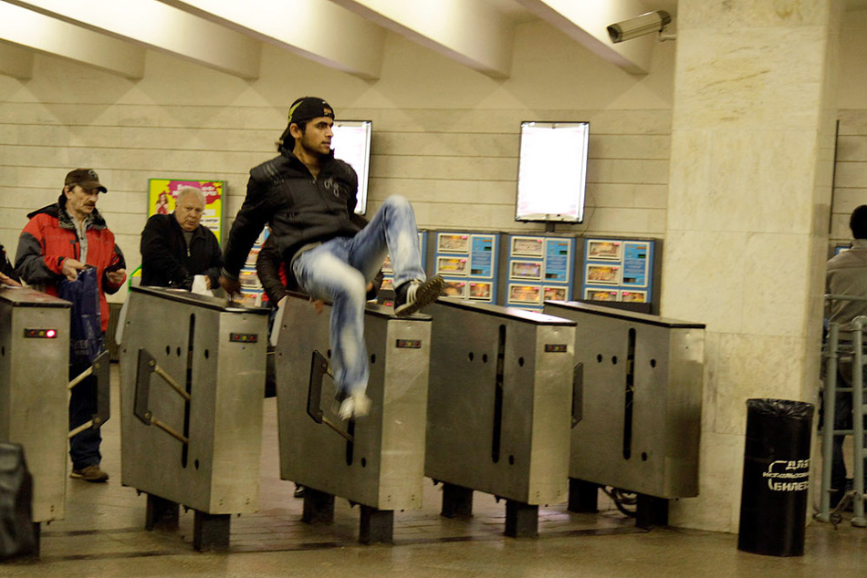
FARE EVASION
is the act of travelling on public transport without paying
Providing a solution for NYPD

Slide 4

WHATS THE ISSUE?
FINANCIAL LOSS
HIGH FARE EVASION CRIME RATE

Slide 5
DATASET
MTA TURN STILE DATASET
ARRESTS FOR FARE EVASION DATASET
SAMPLE:2018
11 COLUMNS , 10M ROWS
SAMPLE:2018
17 COLUMNS , 195,888 ROWS

Slide 6

TOOLS
NUMPY
JUPYTER NOTEBOOK
PANDAS
PYTHON
MATPLOTLIB
SQLALCHEMY
SEABORN

Slide 7
DATA CLEANING
01
02
03
Stripping whitespaces from columns
Duplicated values
Getting rid of irregular readings
04
05
06
Focusing on entries only
Eliminating outliers
Eliminating false readings
(negative values, huge values)

Slide 8
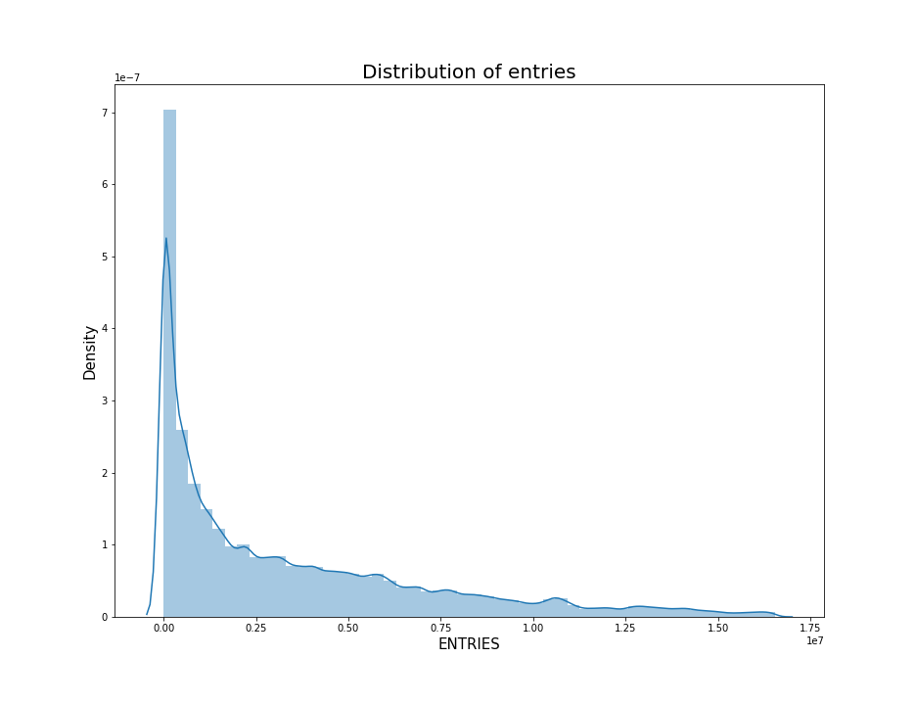
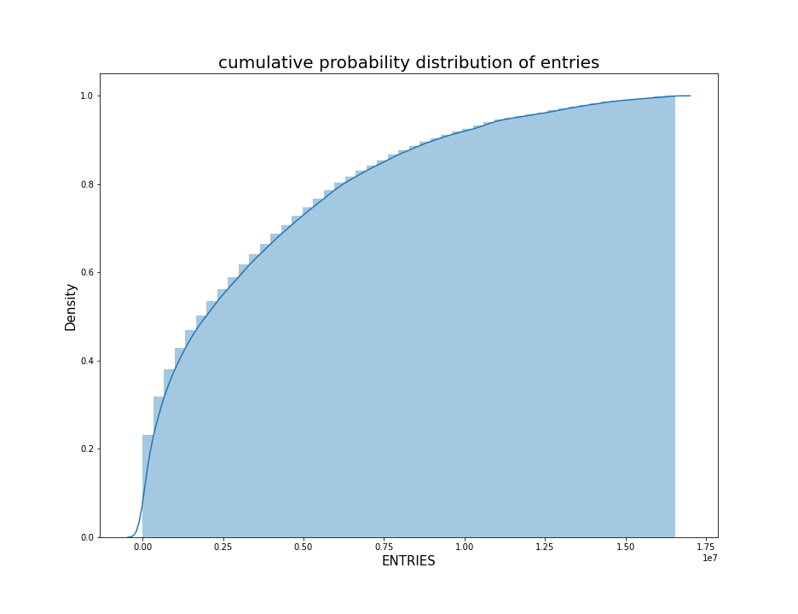
Data Cleaning

Slide 9
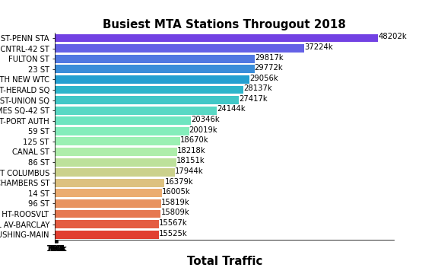
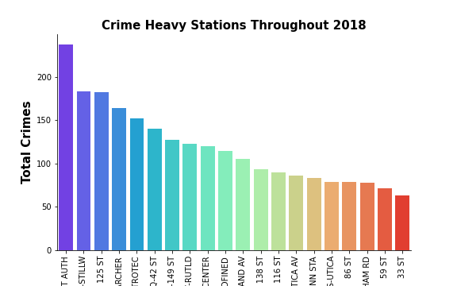
ANALYSIS

Slide 10
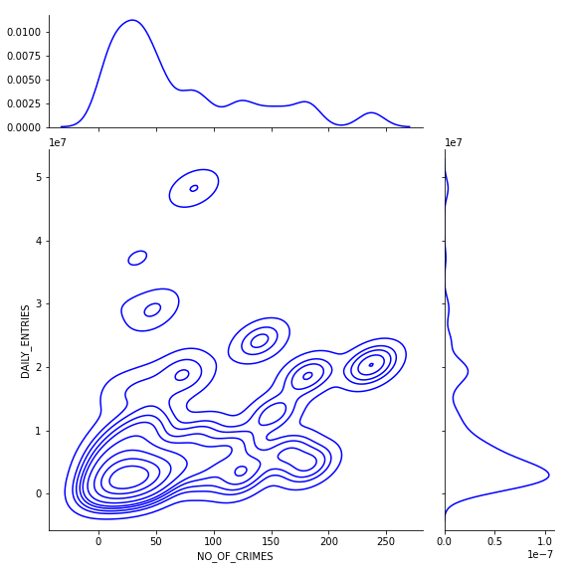
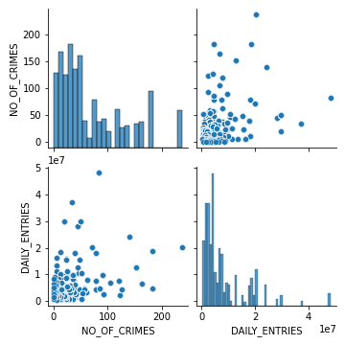
CORRELATION

Slide 11
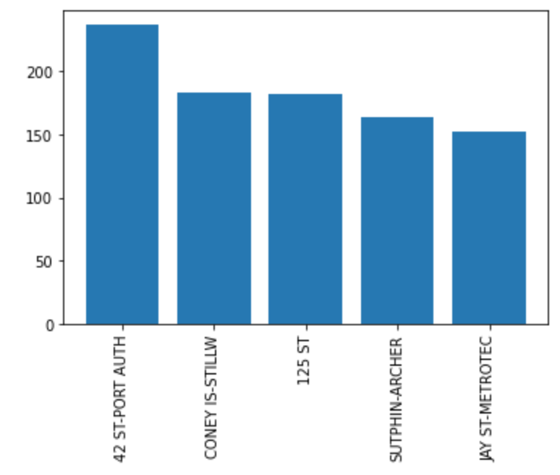
ANALYSIS OF THE TOP HEAVY CRIME STATIONS

Slide 12
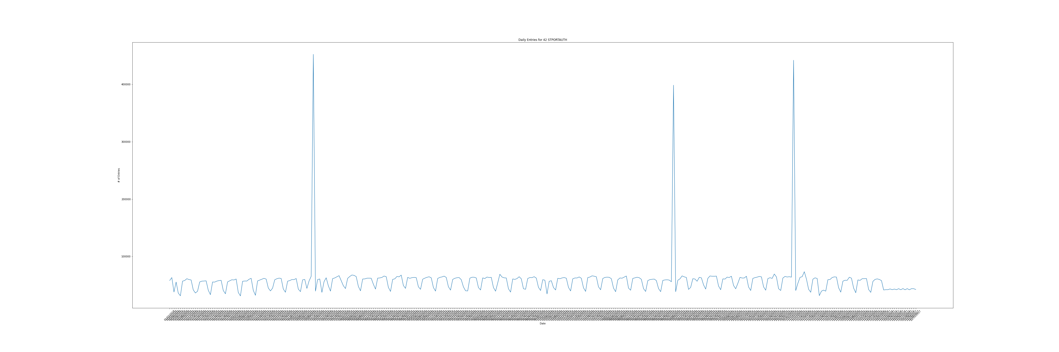
ANALYSIS OF THE TOP HEAVY CRIME STATIONS

Slide 13
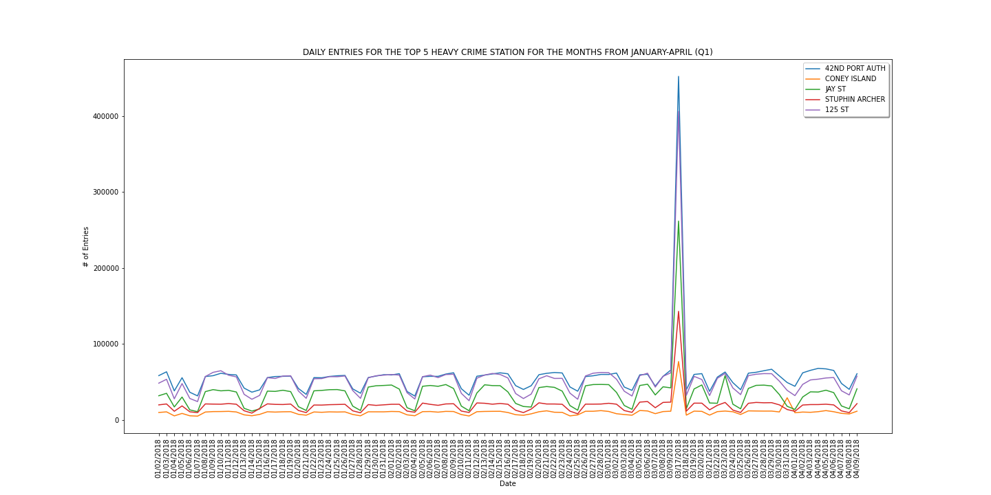
ANALYSIS OF THE TOP HEAVY CRIME STATIONS

Slide 14
ANALYSIS OF THE TOP HEAVY CRIME STATIONS

Slide 15
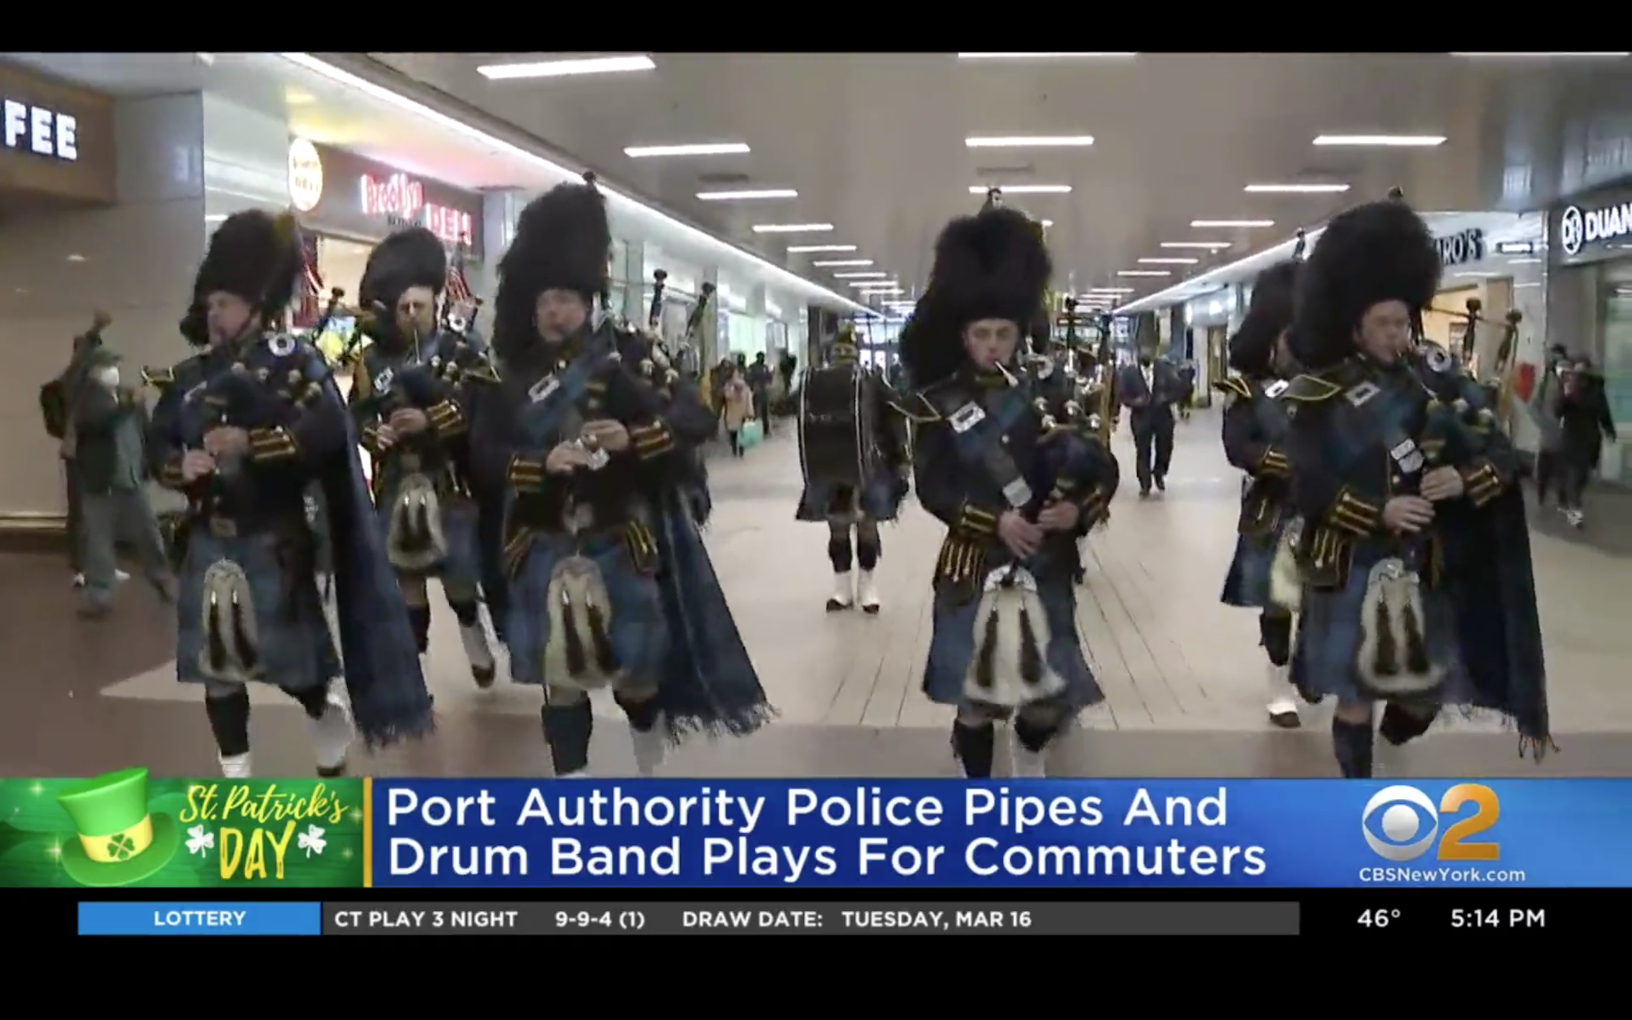
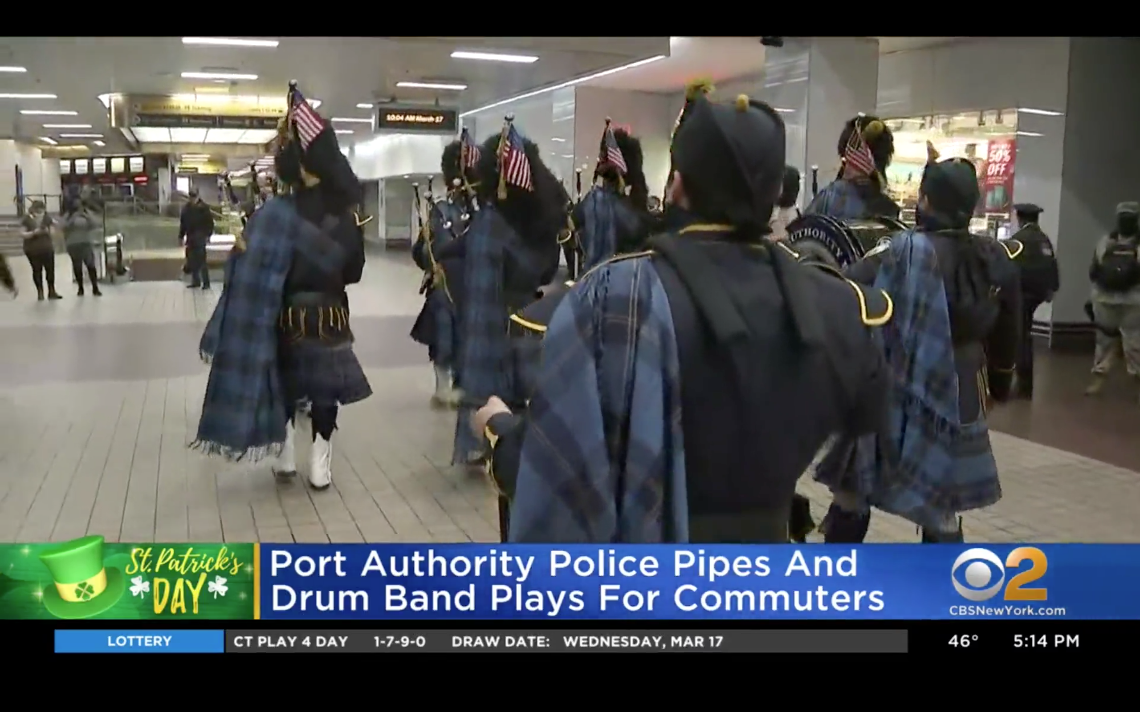
ANALYSIS OF THE TOP HEAVY CRIME STATIONS

Slide 16
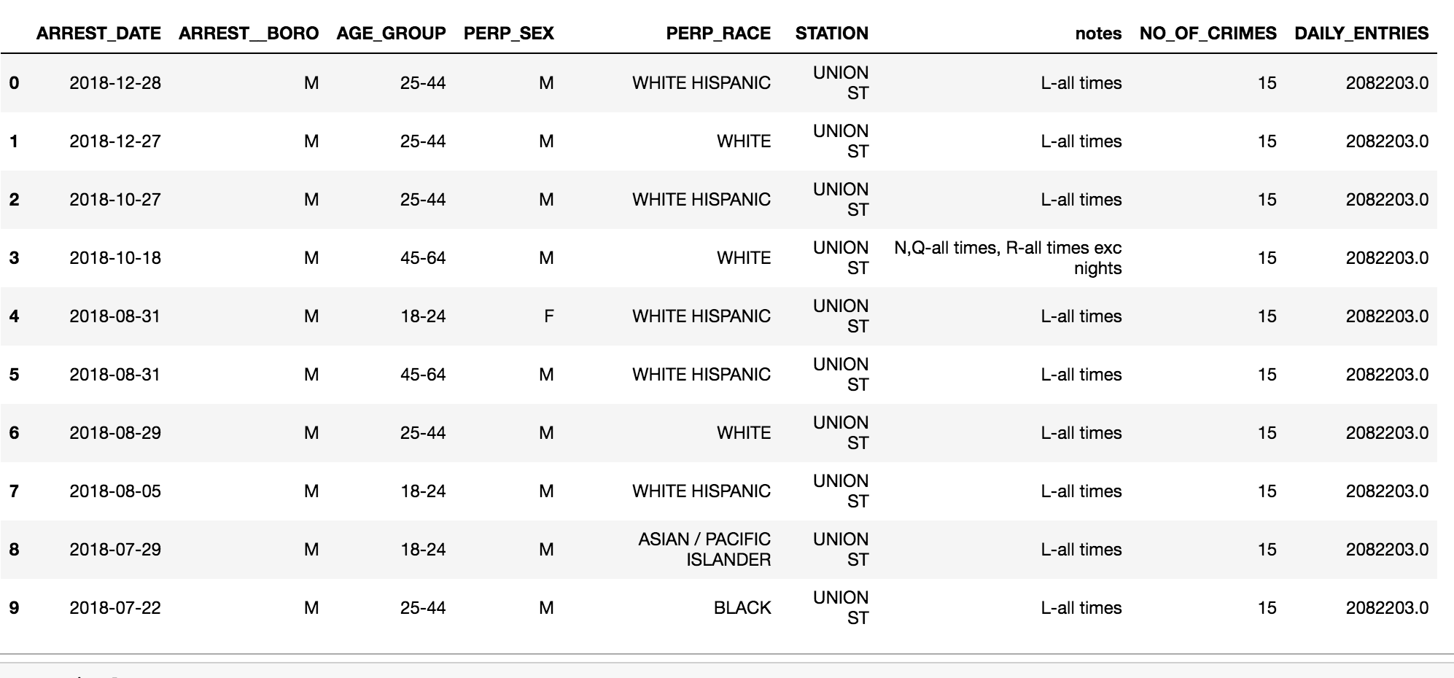
MERGING TWO DATASETS

Slide 17
OBSTECLES
DIFFERENT VALUES WHILE MERGING WILL RESULT IN EMPTY DATAFRAME
MORE VALUES FOR MEANINGFUL CORRELATION

Slide 18
INSIGHTS

Slide 19
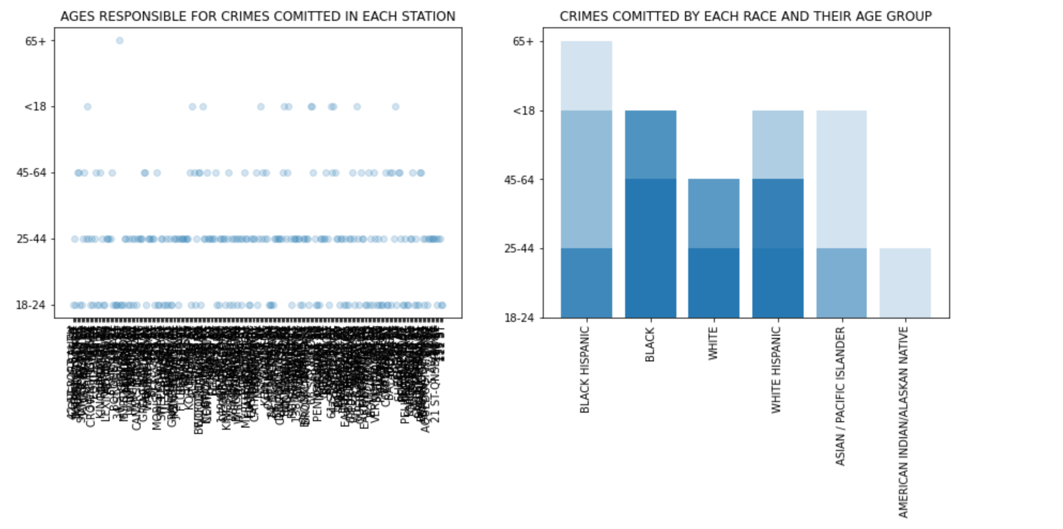
ALL STATIONS

Slide 20
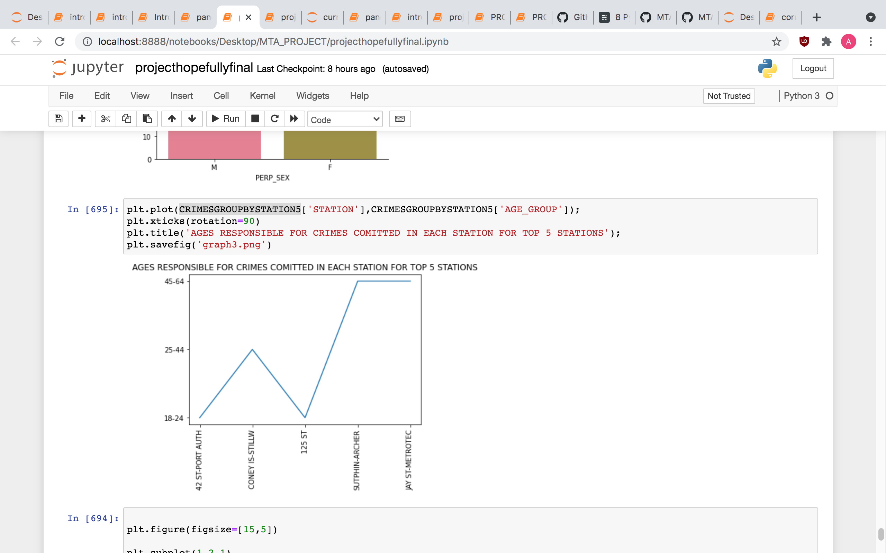
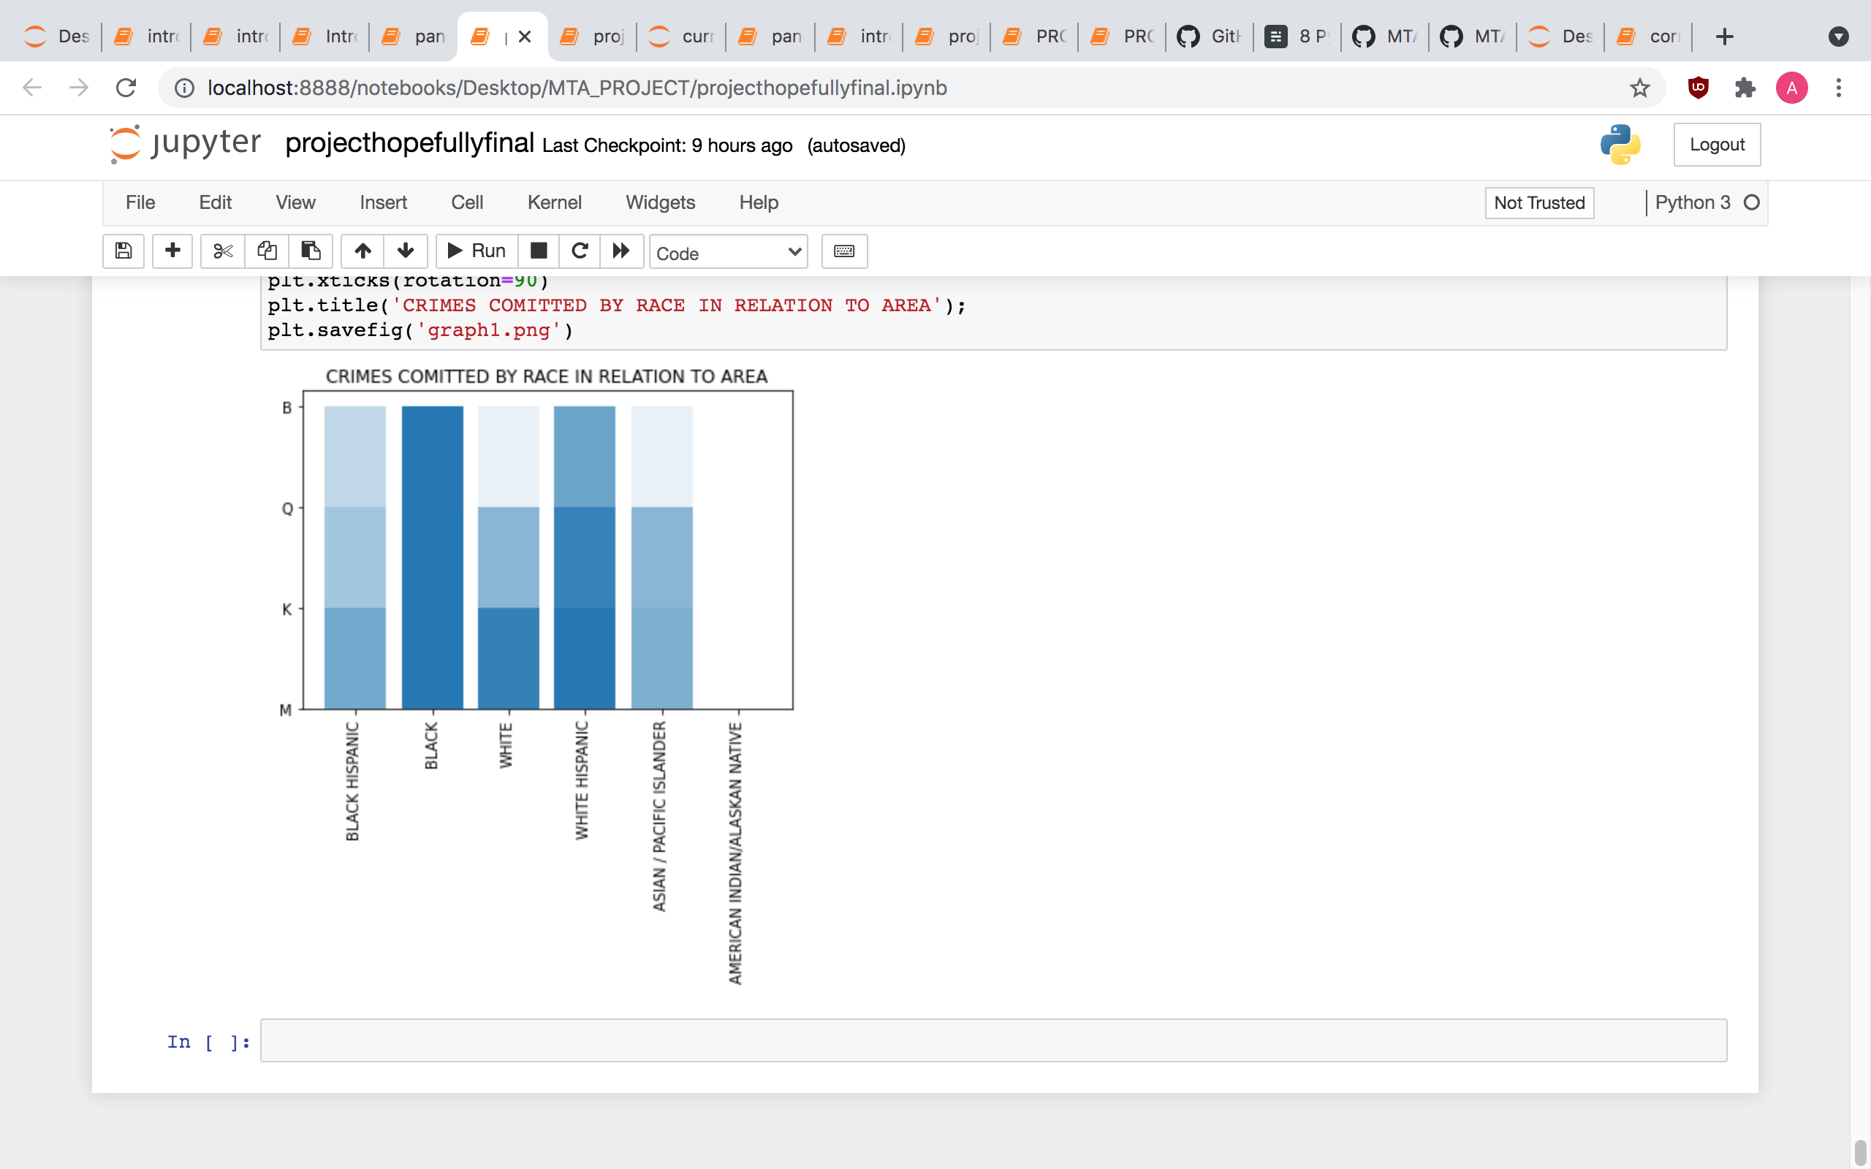
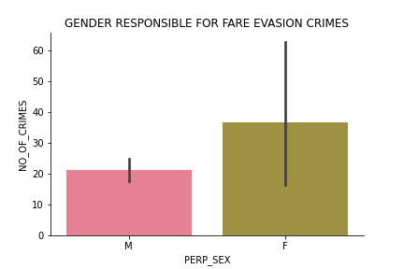

Slide 21

CONCLUSION
There is a correlation between traffic and fare evasion crimes
Holidays are a big cause of fare evasion crimes
Almost everyone commits fare evasion crime
Heavy crime stations will continue to grow

Slide 22

RECOMMENDATIONS
01
01
03
SURVAILING THE ALREADY KNOWN STATIONS FOR CRIME
DISTIRBUTING MANPOWER (PLOICE OFFICERS) DURING THE HOLIDAYS
DISTIRBUTING MANPOWER (PLOICE OFFICERS) DURING THE WEEKENDS
02
02

Slide 23

THANKS!
ANY QUESTIONS?

